Slide 1

Open source and freeware FPGA tools
Presented By Shaibal Saha
Email: shaibalsaha@Oakland.edu
Date: 10.31.2022

Slide 2
Introduction
FPGA is hard to configure sometimes.
There is a way to go about it without breaking the sweat.
Using open source FPGA tools helps us to get the accurate design of our program.

Slide 3
Why do need open source FPGA tools
FPGA Simulation
  has to do with the testing or evaluation of the systems ahead of the final design.
  using an Opensource FPGA helps to save you money.
  you only get to pay a little amount of money to access these tools.
Cross system analysis
  to use the varieties of Opensource FPGA tools to test the systems across their respective platforms.
  With the cross-platform undertone of the Opensource FPGA tools, you can check for simulation and development across different platforms.
  Third-party platforms that come together with a common goal of enabling real-time FPGA configurations.

Slide 4
Explore opensource tools in this presentation
JHDL - https://web.archive.org/web/20061205060548/http://jhdl.org/
Opencores- www.opencores.org
GHDL- http://ghdl.free.fr/
MyHDL- https://www.myhdl.org/

Slide 5
JHDL(Just-Another (Java) Hardware Description Language)
is a set of FPGA CAD tools developed at Brigham Young University's Configurable Computing Laboratory
allows the user to design the structure and layout of a circuit, debug the circuit in simulation, netlist and interface for bit-stream synthesis.
exploratory attempt to identify the key features and functionality of good FPGA tools.

Slide 6
JHDL Quick Start Guide
A java platform , such as the Standard Edition (J2SE) 1.3 (or later) is necessary in order to use JHDL classes.
Testing your java class path with a simple program like printing helloworld
Setting your classpath.
Testing your classpath with jhdl.jar
  java byucc.jhdl.apps.Viewers.AboutJHDL

Slide 7
Steps of Circuit descriptions in JHDL
Import the base library
  import byucc.jhdl.base.*;
  import byucc.jhdl.Logic.*;
Declare your circuit as a class which extends Logic.
Declare the cell interface (ports).
Begin the constructor definition for the circuit.
Call super(parent).
Do connect() calls to hook the constructor parameter wires up to the ports.
Insert your logic using calls such as or_o() and and().

Slide 8
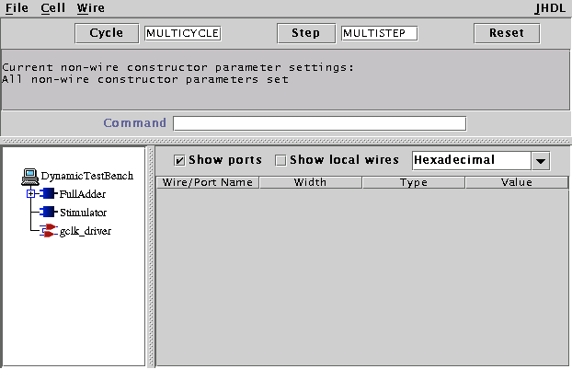
CVT, DTB, and the Simulation Environment
Before continuing confirm that your environment is setup correctly.
With circuit description to simulate using CVT . Type this to load your circuit in CVT
  javac filename.java
start a new Dynamic Test Bench (dtb), which will load your circuit and create a new CVT system to view it.
  java dtb FullAdder

Slide 9
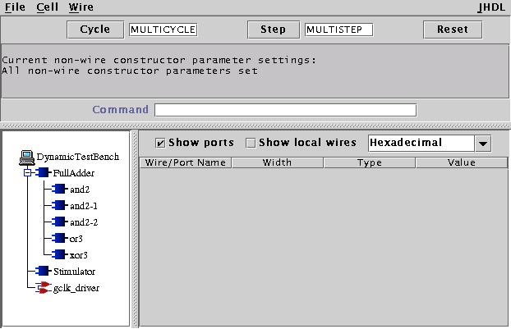
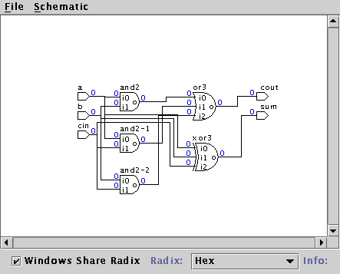
CVT, DTB, and the Simulation Environment
After loading a circuit you will see a tree appear in the left hand pane of the CVT window.
Clicking fulladder will show the full circuit

Slide 10
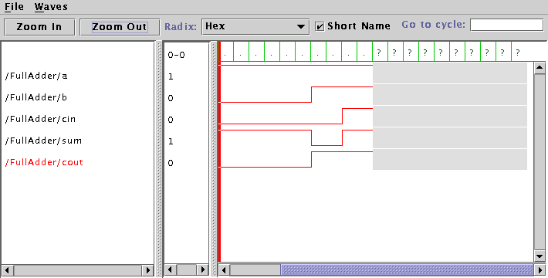
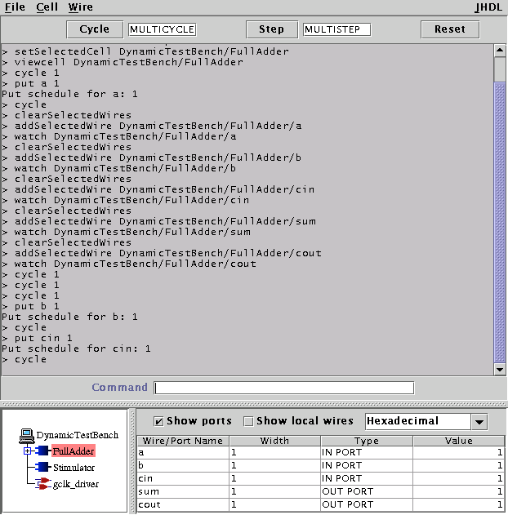
CVT, DTB, and the Simulation Environment
Generating waveform
CLI console

Slide 11
Netlisting
After a design has been verified using simulation, JHDL makes it possible to netlist the design.
  netlist -insertpads t -f FullAdder.edn
Tells it to first automagically insert I/O drivers for the top-level ports on your circuit
It then tells it to generate EDIF and write that into the file FullAdder.edn

Slide 12
Dynamic Testbench (DTB)
turns out that JHDL designs can be executed by writing a programmatic testbench which will build your circuit, step the clock, send stimulus into your circuit, and check the outputs for correctness.
Backend tools
  After creating EDIF netlist, need to run the FPGA vendor’s tools which convert netlist to bitstream

Slide 13
Opencores
Established in 1999.
Most prominent online community for the development of gateware IP cores.
Place where such cores are shared and promoted in the spirit of Free and Open Source collaboration.
shared and promoted in the spirit of Free and Open Source collaboration.
supports the users’ community providing a platform for listing, presenting, and managing such projects with version control for source management.
meet to showcase, promote, and talk about their passion and work.

Slide 14
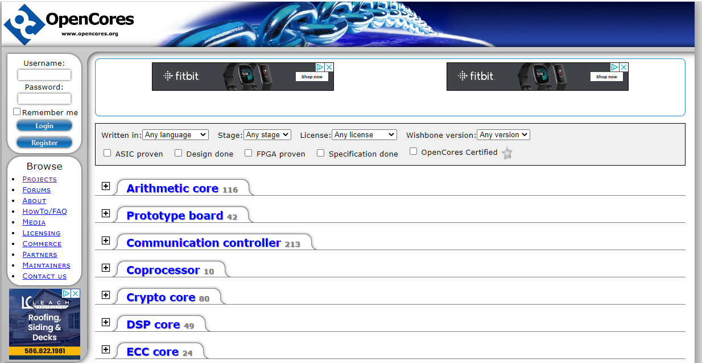
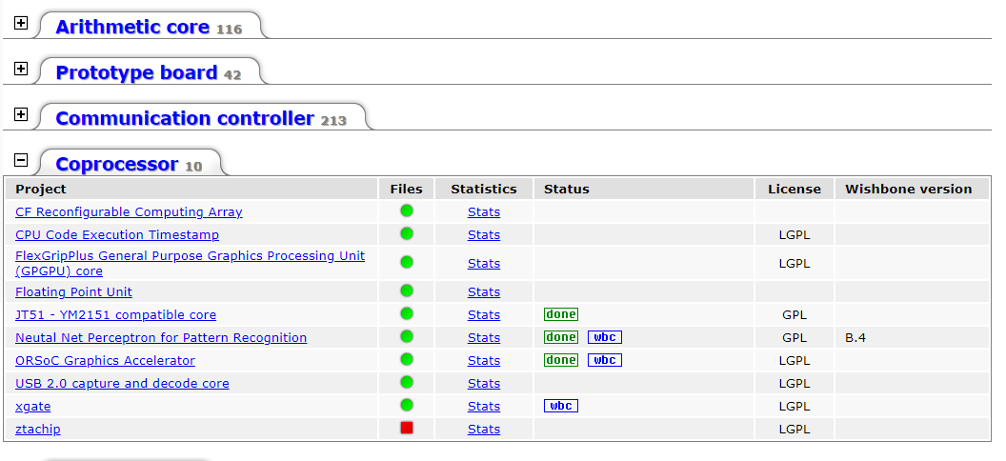
Opencores
Different projects in the community and sort it as well as filter those to find their problems to discuss

Slide 15
Opencores (What is Use of of that community)
Place to project management.
For every OpenCores projects a number of pages are created upon startup:
  Overview > News > Downloads
Opencores certified projects:
  RTL design files (VHDL / Verilog / C / assembler / etc).
  Testbenches (self-checking).
  Documentation (design and testbench specifications, FPGA/ASIC size information).
  Make-scripts (compile-, testbench-, synthesis scripts).
  Information about Design-usage meaning, has it been verified on actual hardware, is it being used in commercial products. This information builds allot of creditability.

Slide 16
GHDL(G Hardware Design Language)
An open-source simulator for the VHDL language .
Allows you to compile and execute your VHDL code directly in your PC .
Supports the 1987, 1993, 2002 versions of the IEEE 1076 VHDL standard, and partially the latest 2008 revision (well enough to support fixed_generic_pkg or float_generic_pkg)
Using a code generator (llvm, GCC or a builtin one), GHDL is much faster than any interpreted simulator.
Runs on Linux, Windows and Apple OS X.
freely download a binary distribution for your OS or try to compile GHDL on your own machine.
Github Link- https://github.com/ghdl/ghdl

Slide 17
More about GHDL
It can handle very large designs, such as leon3/grlib
Can write waveforms to GHW, VCD or FST files. Combined with a GUI-based waveform viewer and a good text editor.
very powerful tool for writing, testing and simulating your code.
Co-simulation with foreign applications is supported through Verilog Procedural Interface (VPI) and/or VHPIDIRECT
Can synthesize arbitrarily complex VHDL designs into a VHDL 1993 netlist, which can be implicitly or explicitly used in open source or vendor synthesis frameworks.
Supported third party projects: Yosys , OSVVM, UVVM

Slide 18
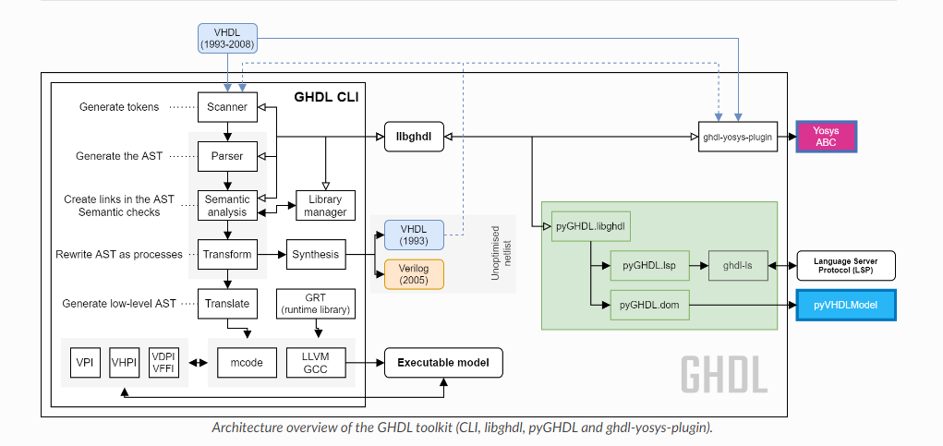
GHDL Architecture

Slide 19
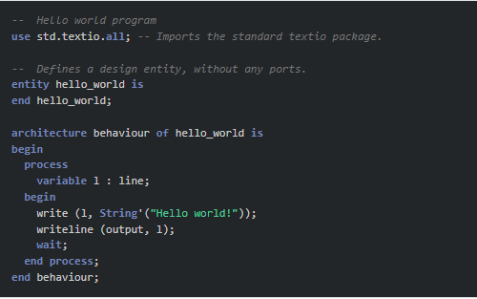
How to code in GHDL and simulate
Both .vhdl and .vhd is supported by GHDL and .v file for Verilog
Compile the file with ghdl -a hello.vhdl in the shell/terminal
Creates the files named work-obj93.cf
Run ghdl –e hello_world .
Lastly Run ghdl –r hello_world to launch the simulation directly.

Slide 20
GHDL Waveform
Libghw
  reading features are provided as a shared library, which is built and installed with GHDL by default
Ghwdump
  For debugging and learning purposes, ghwdump uses ghdlib for dumping the content of GHW waves into text files. ghwdump is also built and installed with GHDL by default. It’s used in the GHDL test suite for catching regressions.

Slide 21
GHDL simulation and runtime debug
Ghdl begins with –g for any debugging options and –o for optimization options.
--help will provide list of ghdl options including debugging ones.
  --trace-process ( Display process name before each cycle)
  --stats (Display runtime statistics)
  --checks (do internal check after each process)
  -- bootstrap allow (--work=std)
  Ghdl begins with –g for any debugging options and –o for optimization options
Gnu debugging
  can be useful to catch a runtime error, such as indexing an array beyond its bounds.
  set a breakpoint like this:
    (gdb) break __ghdl_fatal

Slide 22
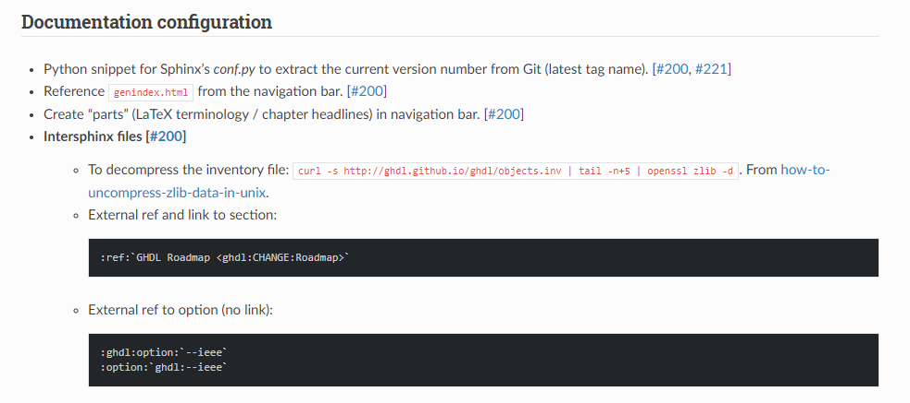
GHDL coding style
For the style of coding someone can follow the below links
  https://ghdl.github.io/ghdl/development/CodingStyle.html

Slide 23
MyHDL
a free, open-source package for using Python as a hardware description and verification language.
The built-in simulator runs on top of the Python interpreter.
It supports waveform viewing by tracing signal changes in a VCD file.
With MyHDL, the Python unit test framework can be used on hardware designs.
Subject to some limitations, MyHDL designs can be converted to Verilog or VHDL. This provides a path into a traditional design flow, including synthesis and implementation.
Finally, the converter automates a number of tasks that are hard in Verilog or VHDL directly. A notable feature is the automated handling of signed arithmetic issues.

Slide 24
MyHDL
a free, open-source package for using Python as a hardware description and verification language.
The built-in simulator runs on top of the Python interpreter.
It supports waveform viewing by tracing signal changes in a VCD file.
With MyHDL, the Python unit test framework can be used on hardware designs.
Subject to some limitations, MyHDL designs can be converted to Verilog or VHDL. This provides a path into a traditional design flow, including synthesis and implementation.
Finally, the converter automates a number of tasks that are hard in Verilog or VHDL directly. A notable feature is the automated handling of signed arithmetic issues.
New version released on 31st May,2019 myhdl 0.11.0.
Python 3 supported

Slide 25
Benefits of using MyHDL
Integrates seamlessly.
Silicon proven
Open Source

Slide 26
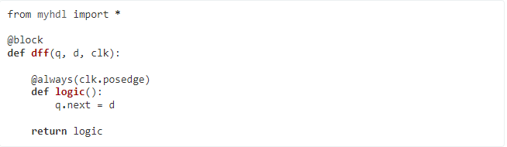
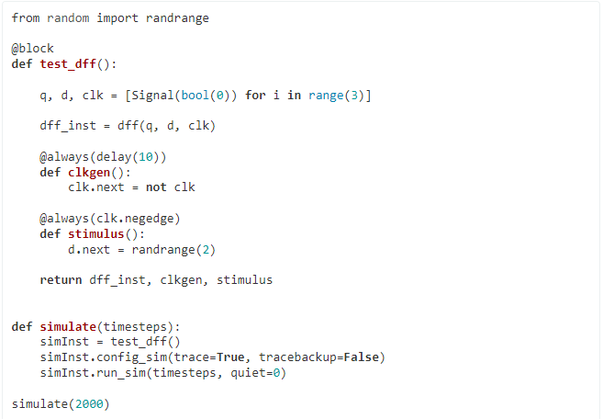
Architecture of coding and simulation
Description
Simulation

Slide 27
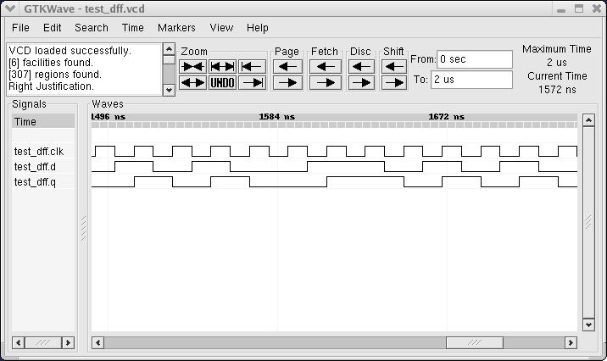
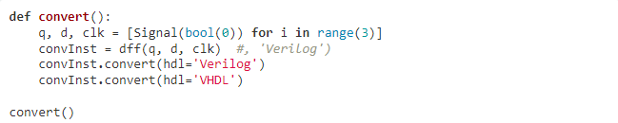
Architecture of coding and simulation of MyHDL
Simulation Waveform
Automatic conversion to VHDL/Verilog

Slide 28
What can possible with MyHDL
Structural modeling
RTL modeling
High level modeling
Unit testing
Conversion to VHDL /verilog

Slide 29
More about MyHDL
FAST
Using PyPy to speed up MyHDL simulations
Benchmark | MyHDL@cPython | MyHDL@pypy | Speedup factor
timer | 902 | 61 | 14.8
lfsr2 | 1,307 | 67 | 19.5
randgen | 763 | 62 | 12.3
longdiv | 752 | 69 | 10.9
findmax | 670 | 86 | 7.8

Slide 30
More about MyHDL
Comparison to VHDL and Verilog other existing open source tools
Benchmark | MyHDL@pypy | Icarus | GHDL
timer | 61 | 106 | 146 | 260 | 219
lfsr24 | 67 | 79 | 71 | 266 | 240
randgen | 62 | 197 | 34 | 76 | 67
longdiv | 69 | 43 | 224 | 96 | 98
findmax | 86 | 56 | 2256 | 21 | 37

Slide 31
Summary
Open source tools are useful to cross platform application and FPGA simulations.
For Python interpreter , MyHDL is fast than other open source tools, but GHDL has easy to handle.
JHDL is one of the oldest open source tools in the market.
However,
Opencores is used for manage various VHDL projects.
Opencores has a large community to discuss version control of FPGA projects.

Slide 32
References
https://www.myhdl.org/docs/examples/flipflops.html
https://ebics.net/opensource-fpga/
https://opencores.org/howto/project
http://ghdl.free.fr/
http://gcc.gnu.org/
https://github.com/ghdl/ghdl
https://ghdl.github.io/ghdl/development/building/index.html
https://ghdl.github.io/ghdl/internals/index.html
http://docs.myhdl.org/en/stable/manual/highlevel.html
https://www.myhdl.org/docs/examples/flipflops.html
https://www.myhdl.org/docs/performance.html
https://en.wikipedia.org/wiki/JHDL
https://engineering.byu.edu/
https://web.archive.org/web/20061205060548/http://jhdl.org/

Slide 33
  THANK YOU

